Slide 1
Week 1. What is learning?
Dr. Terrence Sejnowski

Slide 2
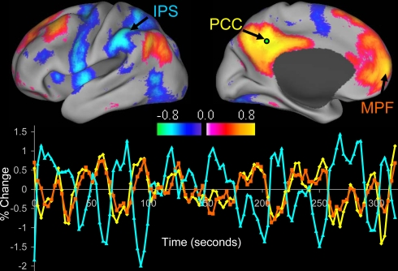
Fox, M. D., Snyder, A. Z., Vincent, J. L., Corbetta, M., Van Essen, D. C., and Raichle, M. E. (2005). The human brain is intrinsically organized into dynamic, anticorrelated functional networks. Proc. Natl. Acad. Sci. U.S.A.
102, 9673-9678
Fig. 1. Intrinsic correlations between a seed region in the PCC and all other voxels in the brain for a single subject during resting fixation. The spatial distribution of correlation coefficients shows both correlations (positive values) and anticorrelations (negative values), thresholded at R _ 0.3. The time course for a single run is shown for the seed region (PCC, yellow), a region positively correlated with this seed region in the MPF (orange), and a region negatively correlated with the seed region in the IPS (blue).

Slide 3
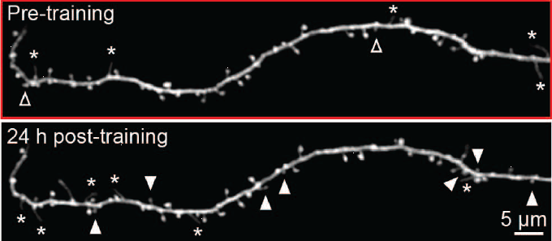
Guang Yang et al. Sleep promotes branch-specific formation of dendritic spines after learning, Science 344, 1173 (2014)
Fig. 1. Motor learning induces branch-specific spine formation. Transcranial two photon imaging in the primary motor cortex of awake, head restrained mice before and after rotarod motor training. An example of an apical tuft branch with high spine formation 24 hours after training. Filled arrowheads indicate newly formed dendritic spines and open ones indicate eliminated spines over a 24-hour interval. Asterisks indicate dendritic filopodia.

Slide 4
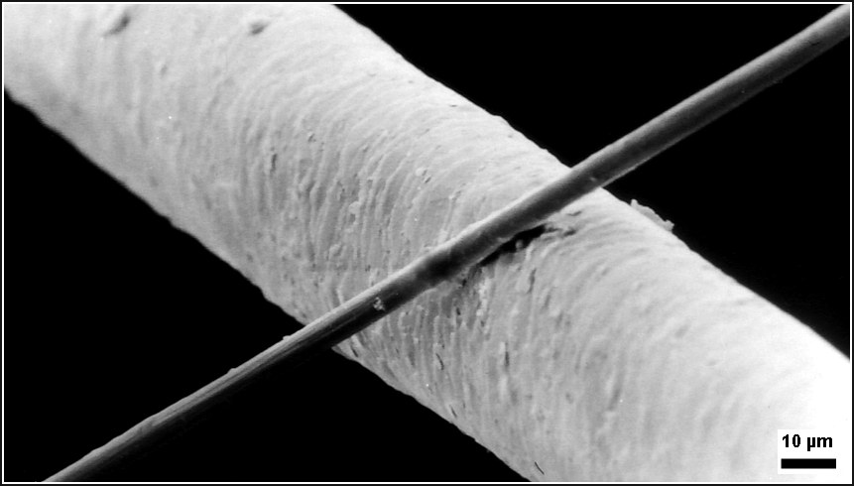

A 6 μm diameter carbon filament (running from bottom left to top right) compared to a human hair, Cfaser haarrp http://en.wikipedia.org/wiki/Carbon_(fiber)#mediaviewer/File:Cfaser_haarrp.jpg
The Chandos portrait of William Shakespeare, thought to be by painter John Taylor, http://en.wikipedia.org/wiki/William_Shakespeare

Slide 5
Other Relevant Readings
Michael D. Fox and Michael Greicius, Clinical applications of resting state functional connectivity , Front. Syst. Neurosci., 16 June 2010
Fox, M. D., Corbetta, M., Snyder, A. Z., Vincent, J. L., and Raichle, M. E. (2006a). Spontaneous neuronal activity distinguishes human dorsal and ventral attention systems. Proc. Natl. Acad. Sci. U.S.A. 103, 10046–10051.

